Slide 1

LEX/FLEX
Scanner Generator in C

Slide 2

Project Title
Presented By
Mahmoud Kolib 200018343
Amgad Nabil 200013199
Omar Mohamed 200013278
Abdelrhman Hossam 200013242
Elsayed Elgarhy 200019526
Under Supervision
DR Nehal A. Mohamed
T.A Toka Abdelhamed

Slide 3
Outline
Introduction
Phases of Compiler
Lexical Analyzer
Software Tools
Inputs of Scanner
Outputs of Scanner
Conclusion
References

Slide 4
Introduction
A compiler is a software that converts the source code to the object code. In other words, we can say that it converts the high-level language to machine/binary language. Moreover, it is necessary to perform this step to make the program executable. This is because the computer understands only binary language
A compiler is similar to an interpreter. However, a compiler is faster than an interpreter and translates the entire file at once. An interpreter reads the source program line by line and, therefore, is a slower process. TurboC++ and Keil are two specific examples of commonly used compilers

Slide 5
Phases of Compiler
Lexical Analysis (Scanning): This phase involves breaking the source code into tokens.
Syntax Analysis (Parsing): This phase involves analyzing the structure of the source code based on the rules of the programming language's grammar.
Semantic Analysis: This phase checks the source code for semantic correctness.
Intermediate Code Generation: In this phase, the compiler translates the source code into an intermediate representation.
Code Optimization: This phase involves improving the intermediate code to make it more efficient.
Code Generation: This phase translates the optimized intermediate code into the target machine language or bytecode.

Slide 6
Lexical Analyzer
The lexical analyzer (generated automatically by a tool like lex, or hand-crafted) reads in a stream of characters, identifies the lexemes in the stream, and categorizes them into tokens. This is termed tokenizing. If the lexer finds an invalid token, it will report an error. Following tokenizing is parsing

Slide 7
Software Tools
TINY compiler is a simple programming language designed for educational purposes.
Flex Software is a powerful tool for generating lexical analyzers (scanners) for programming languages.
C-Minus Language: is a simple subset of the C programming language, designed for educational purposes.
VSCODE : the editor used for the project

Slide 8
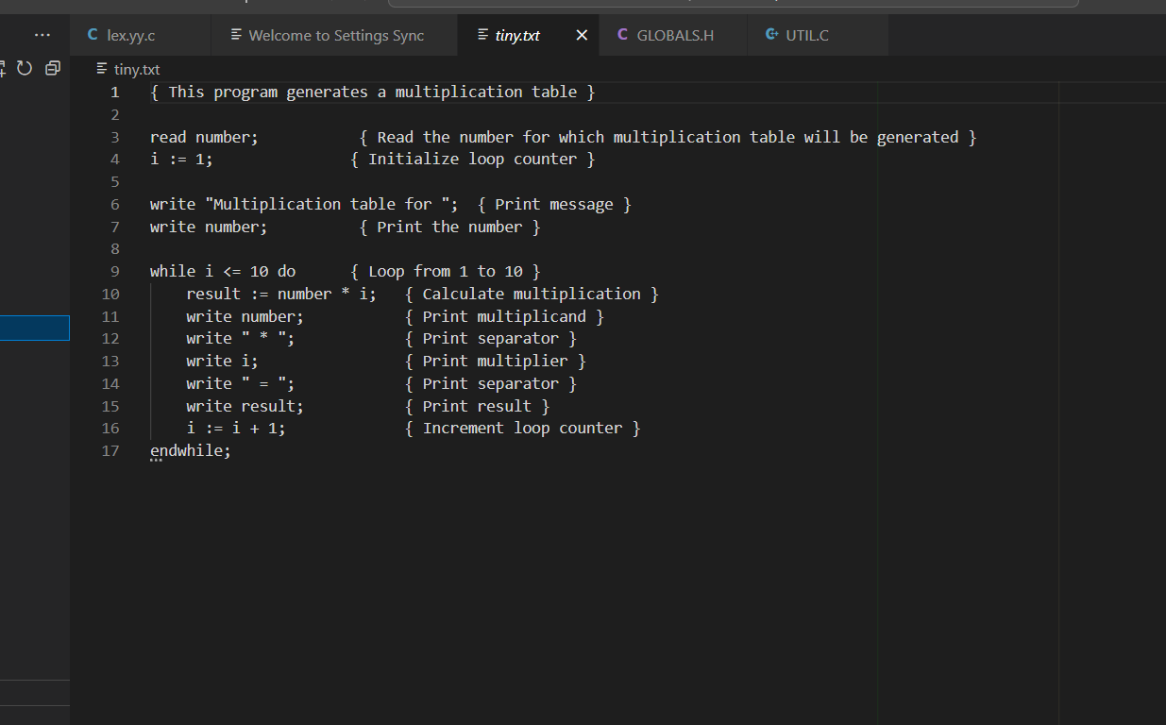
Inputs of Scanner

Slide 9
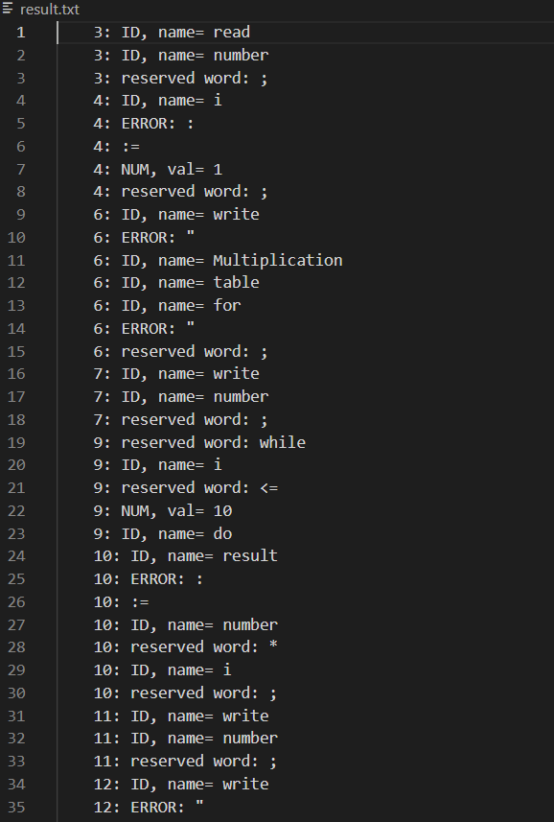
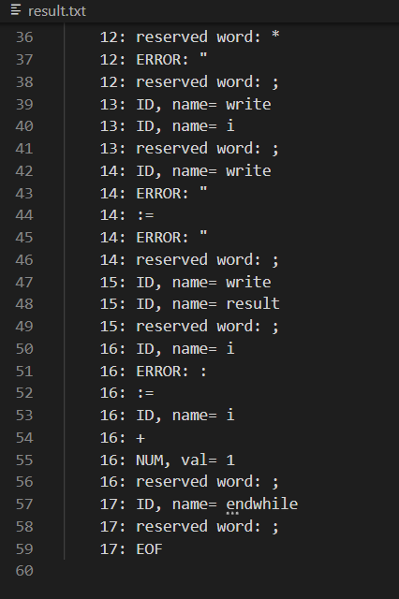
Outputs of Scanner

Slide 10
Conclusion
compilers and lexical analyzers are essential for software development, translating high-level code into machine-readable instructions. Compilers meticulously process code through various stages, ensuring efficient execution across platforms. Meanwhile, lexical analyzers break down source code into tokens, facilitating this process. Together, they enable programmers to express complex logic, driving innovation in the digital sphere.

Slide 11
References
• The book
• Compiler Constructions (Kenneth c. Louden)
• Compilers Principles & techniques and Tools

Slide 12


